Slide 1

Solution Design 1: Design Sprint
Notes:
Speaker Notes:
Introduce yourself (name, major, maybe a fun fact!)
In this workshop, we’ll be discussing and practicing skills around designing a solution within a series of constraints.

Slide 2
BUILD
IDEA
LAUNCH
LEARN
Notes:
Speaker Notes:
Most product teams have to go through this cycle. They have to build something, go through the trouble of launching it and putting it in the hands of users, learning from the users and how they’re using the product, ideate on how they can improve the product, then repeat. This is an incredibly time-consuming and expensive process, and most of the time and money is concentrated in the “Build” and “Launch” phases.

Slide 3
BUILD
IDEA
LAUNCH
LEARN
Notes:
Speaker Notes:
What if we could shorten the cycle to something like this?

Slide 4
UNDERSTAND
DEFINE
SKETCH
DECIDE
PROTOTYPE
VALIDATE
Notes:
Speaker Notes:
Today we’re going to do an exercise called a design sprint, which outlines six steps to designing any solution.
First, we aim to understand and define. Specifically, we want to understand/define the problem and the user who’s faced with this problem.
Next, we’ll sketch and decide. For this step, we’re going to be ideating on ideas using pictures -- don’t worry if you’re not an artist, you’ll be just fine! -- and decide on which idea is “best” as a team.
Lastly, we prototype and validate. This is when we build a paper prototype and use it to test our assumptions.
Oh and by the way, this exercise is usually done with product teams over the course of a 5-day work week, but we’re going to sprint through it in a few hours :)

Slide 5
design sprint: five part workshop
Part 1 [10 mins] | Part 2 [8 mins] | Part 3 [5 mins] | Part 4 [20 mins] | Part 5 [20 mins] | Part 6
You’ll identify the user and map out their problem | You’ll sketch competing solutions on paper | You’ll make difficult decisions and turn your ideas into a testable hypothesis | You’ll hammer out a realistic prototype | You’ll test it with real life humans | Demo and Celebrate
Notes:
Speaker Notes:
So what will this workshop actually look like?
First, we’ll break up into teams -- and all of this will be done in that team.
For Part 1, we’ll try to identify the user and map out their problem.
For Part 2, we’ll sketch solutions on a piece of paper using a method called “crazy eights.”
For Part 3, we’ll vote on which idea to go with.
For Part 4, we’ll use the Marvel app (https://marvelapp.com/) to create usable prototypes out of paper mock-ups.
For Part 5, we’ll test it out on each-other and see what we learn.
Lastly, in part 6, we’ll all take a moment to demo and celebrate what we’ve accomplished :)

Slide 6
the problem:
it’s hard to buy hats and glasses virtually and ensure that they look and feel good while being worn
Notes:
Speaker notes:
The point of this workshop is to help us actually solve a problem, and for the sake of the exercise, let’s say this is the problem we want to solve: it’s hard to buy hats and glasses virtually and ensure that they look and feel good while being worn.

Slide 7
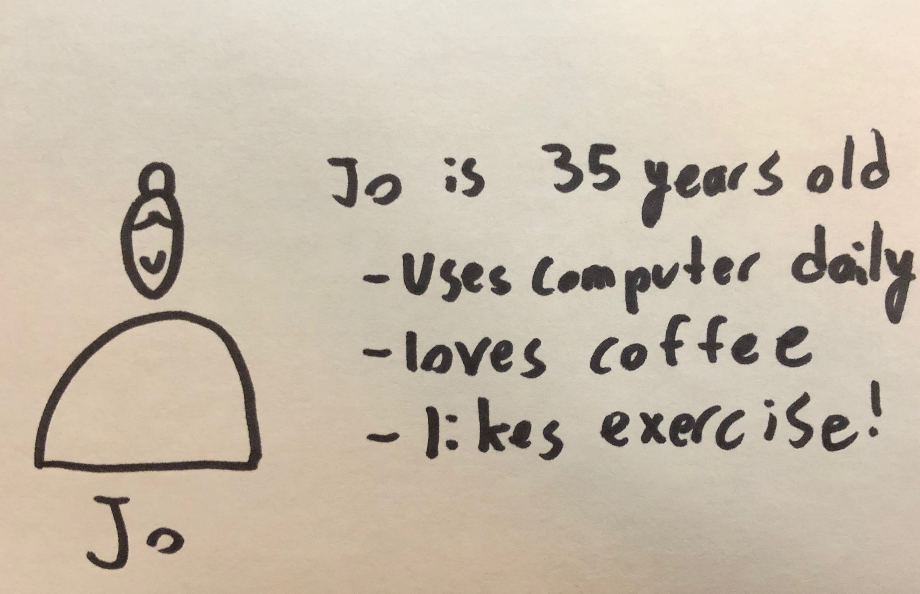
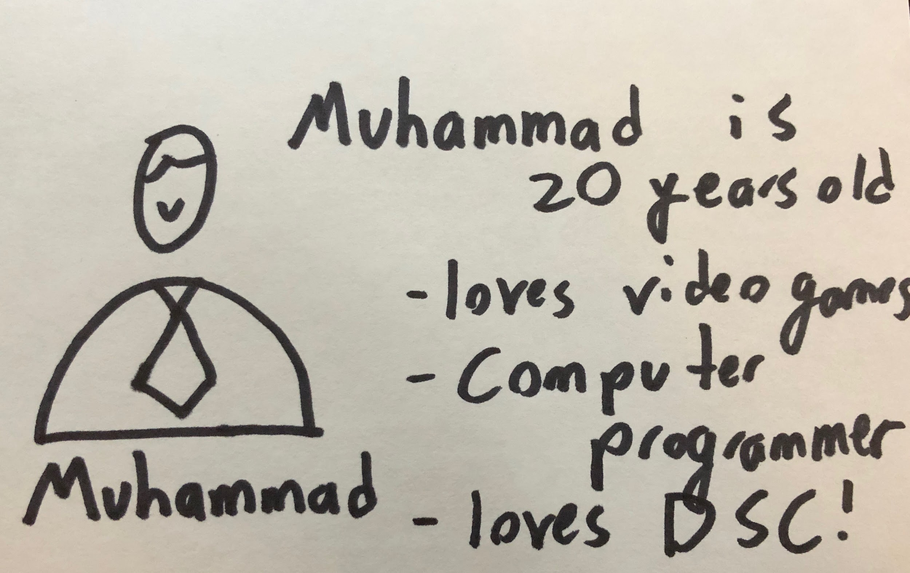
part 1: map
[10 mins]
Notes:
Speaker notes:
In the first step of solving this problem, we’ll try to identify the user and map out their problem.
This will be a 10 minute activity where we’ll create 2 user personas. Each team should take two pieces of paper and a marker. Together, draw a picture of your user and give them a name -- yes, this is actually important because it helps you communicate about the personas. Then, write down a few characteristics that’ll help define them as a user of your product.

Slide 8
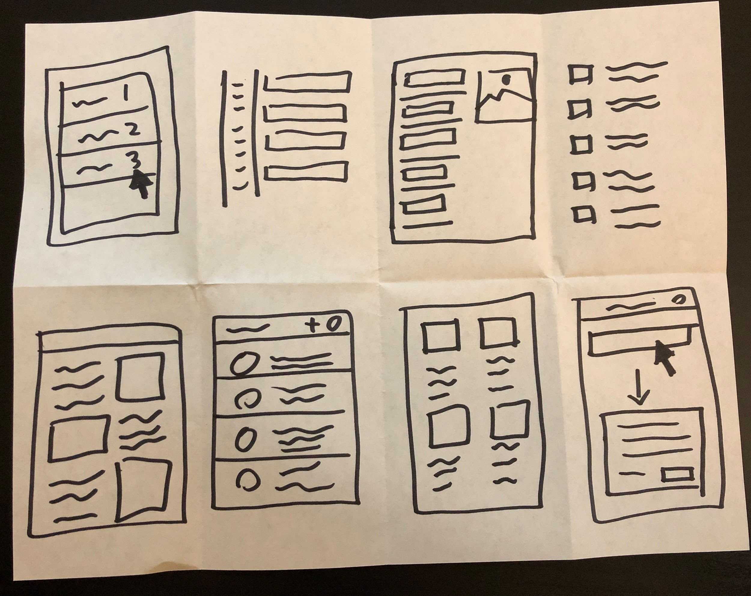
part 2: sketch
[8 mins]
Notes:
Speaker Notes:
For Part 2, we’ll be doing “crazy eights.” Each member of the team should take a piece of paper and fold it up like you see on the screen. In 8 minutes, each member should write an idea down in each rectangle, generating eight ideas -- hence, the name “crazy eights.” When you’re generating these ideas and writing them down, try and keep in mind the problem and the user, but be sure to draw or write down any ideas that come to your mind, completely unfiltered -- this will help keep the creative juices flowing!

Slide 9
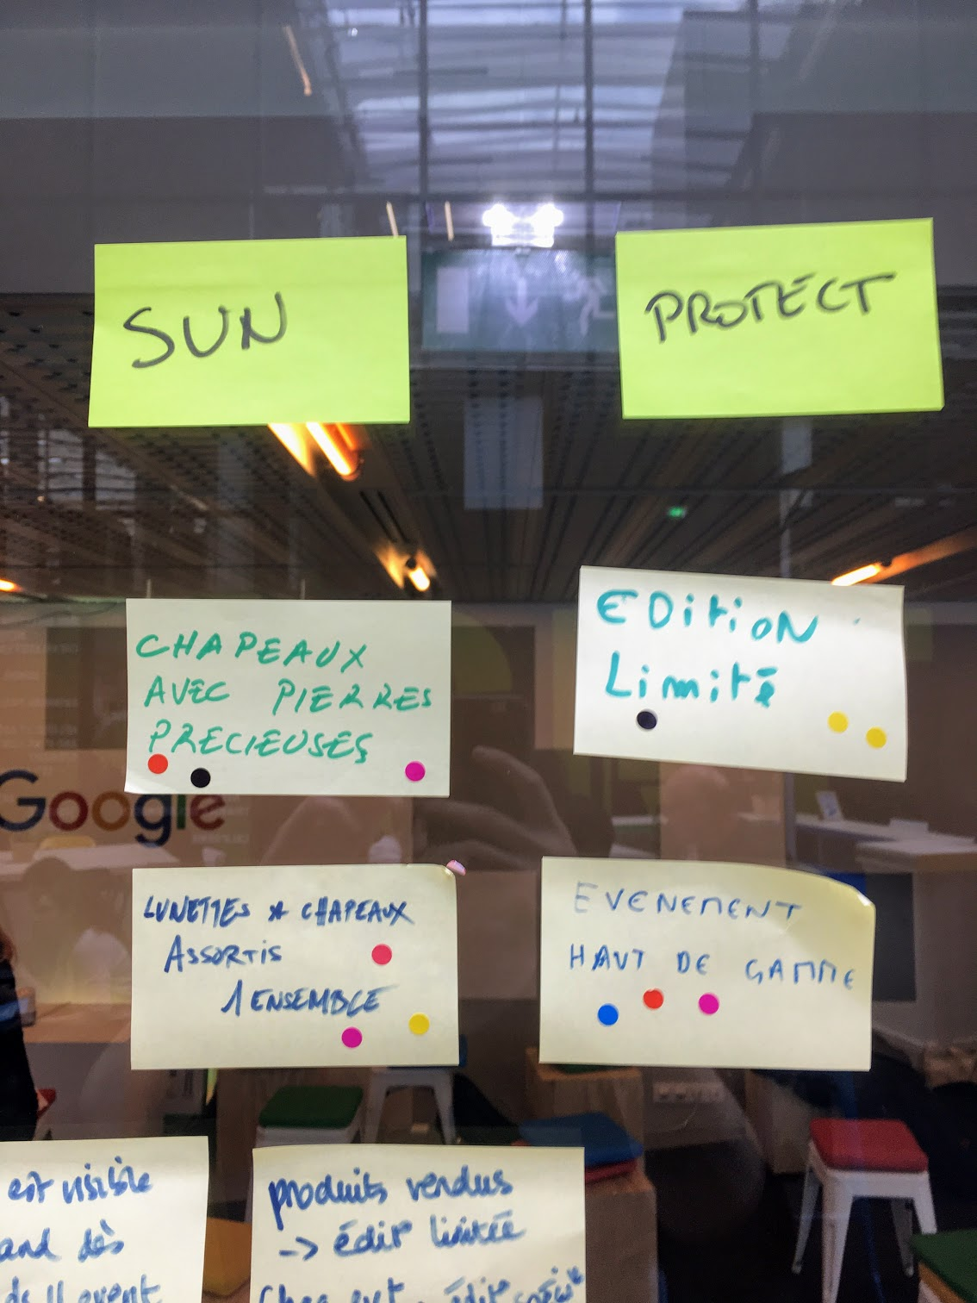
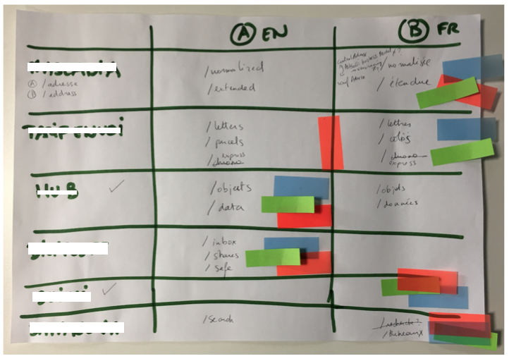
part 3: decide
[5 mins]
Notes:
Speaker Notes:
Next, put all of the ideas down on a table or up on an easel -- it’s time to vote! We’ll be the using dot-voting system and each member gets 3 votes -- they can vote for whatever they want as many times as they want. The idea with the most votes wins!

Slide 10
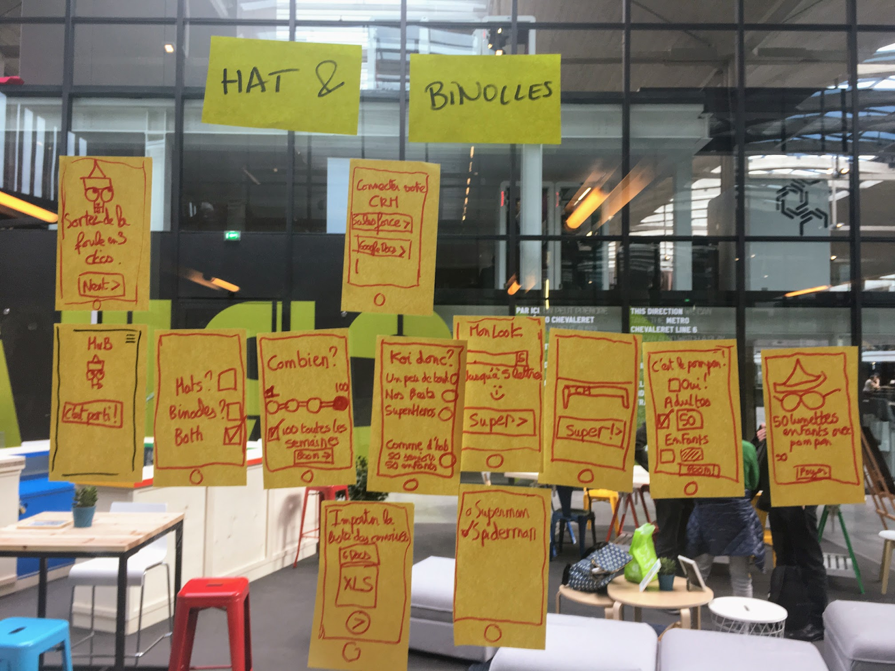

part 4: prototype
[20 mins]
Notes:
Speaker Notes:
Now that we have an idea, it’s time to prototype. As a team, you should decide what the different views in the product should be. Then, draw them out with a marker on paper and use the “Marvel” app to string them together into a usable, testable prototype. You have 20 minutes for this step!

Slide 11
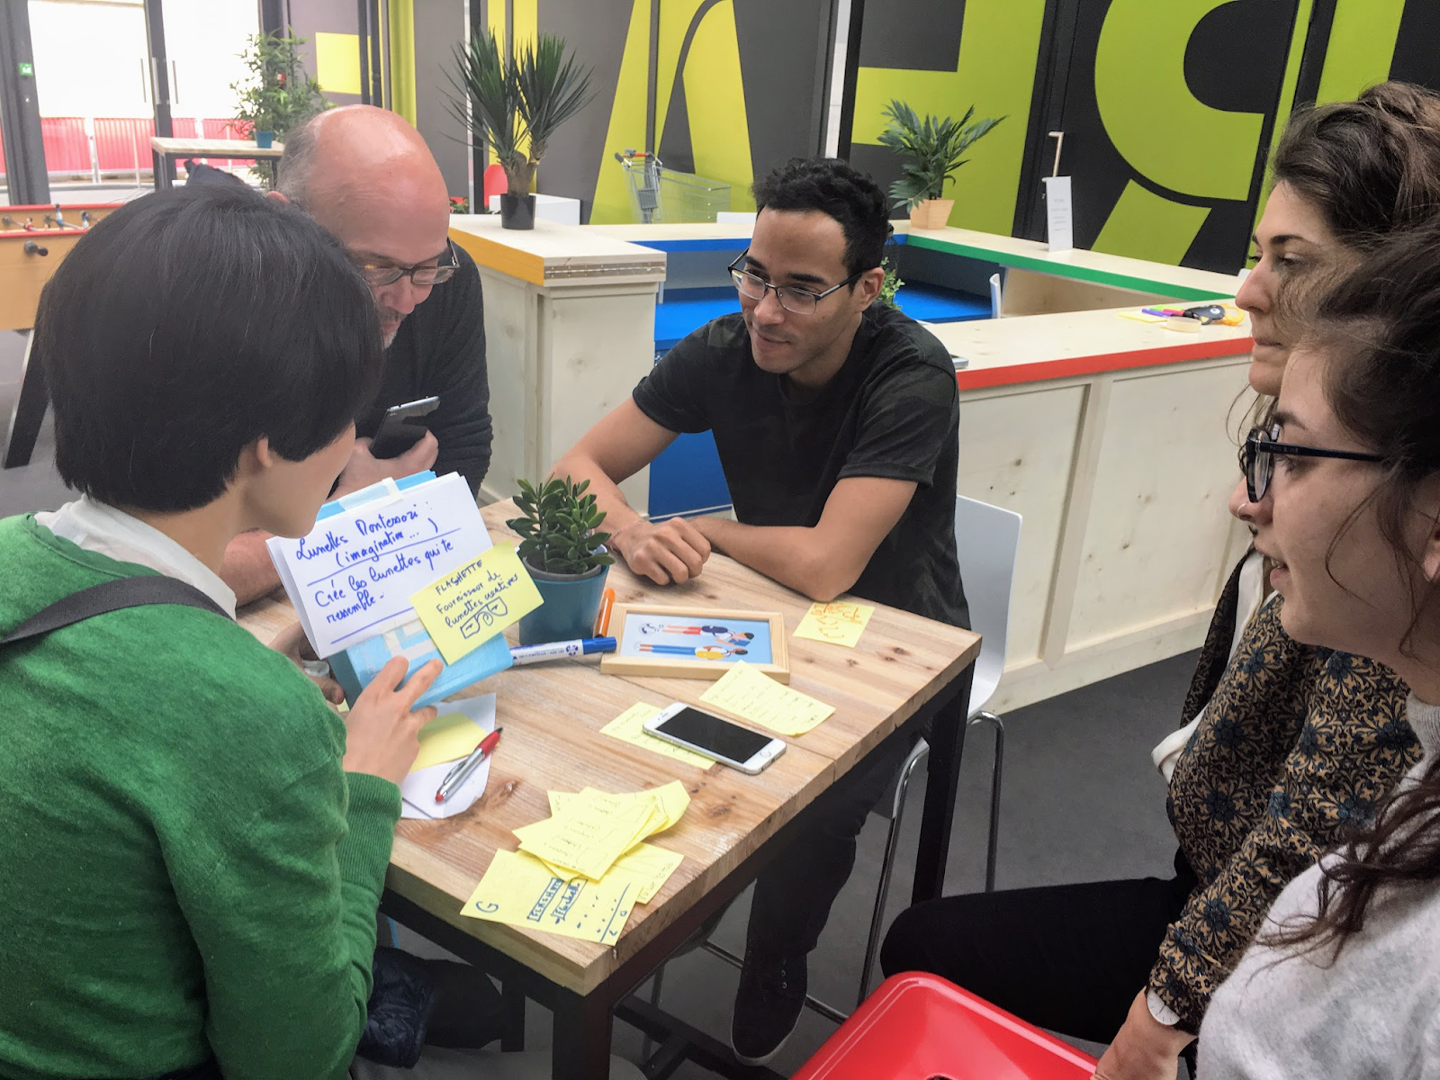
part 5: testing
[20 mins]
Notes:
Speaker Notes:
At step, 5, we’ll be almost done. We have a prototype and it’s time to test. To do this…
First, split your team up in half.
Then, each half-group should find another half-group (of course, this half-group should be from a separate whole-group).
Each half-group should take turns testing their prototype on each other.
You should have time for each half-group to test and be tested TWICE, meaning that the whole group has tested the prototype FOUR times.
Once you’re done testing, come together and discuss your learnings.

Slide 12
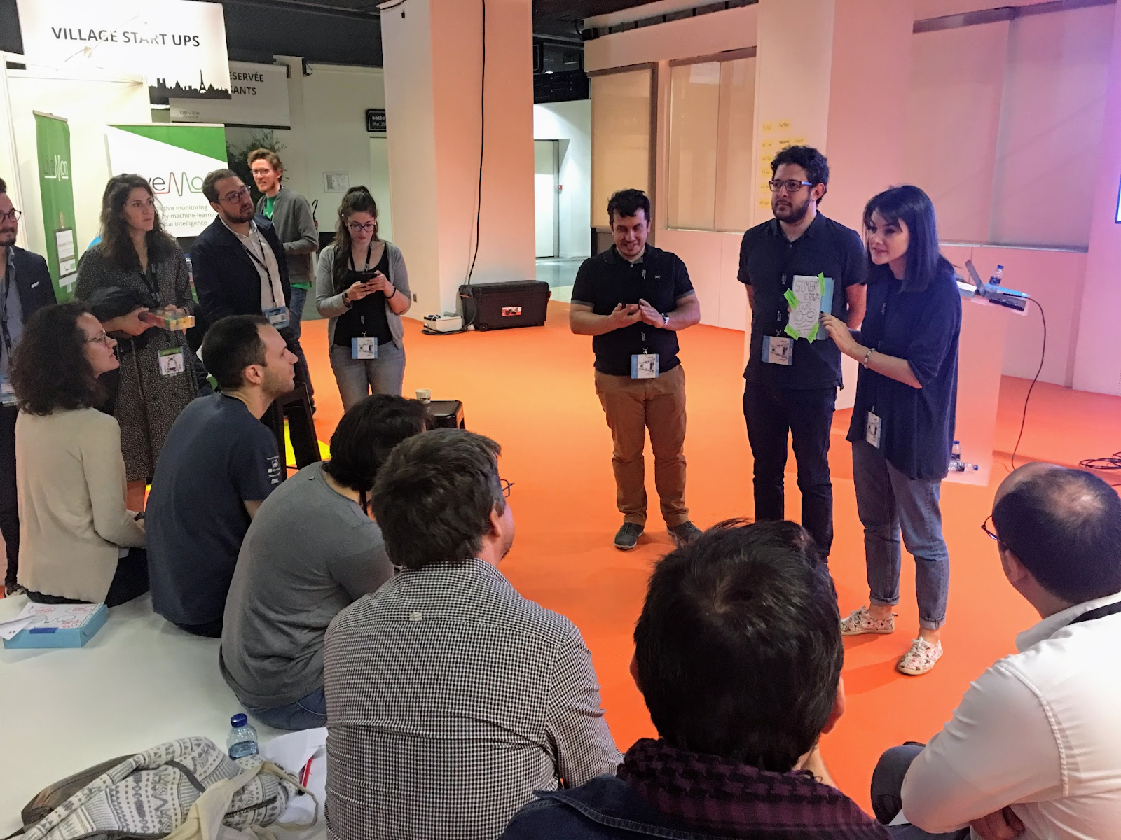
part 6: present
Notes:
Speaker Notes:
Lastly, each team should take a couple of minutes to present. You can talk about your user personas, a few of your ideas, your final prototype, and what you learned from testing!

Slide 13
design sprint: five part workshop
Part 1 [10 mins] | Part 2 [8 mins] | Part 3 [5 mins] | Part 4 [20 mins] | Part 5 [20 mins] | Part 6
You’ll identify the user and map out their problem | You’ll sketch competing solutions on paper | You’ll make difficult decisions and turn your ideas into a testable hypothesis | You’ll hammer out a realistic prototype | You’ll test it with real life humans | Demo and Celebrate
Notes:
Speaker Notes:
Ready? Let’s start by breaking up into groups (you can facilitate this however you see fit). I’ll leave this schedule up so we can reference it throughout the exercise!
To speaker:
(At this point, you should begin the workshop and try to keep everyone to the allotted times so the workshop doesn’t become too long. Walk around and answer questions and most of all -- have fun!).

